Slide 1
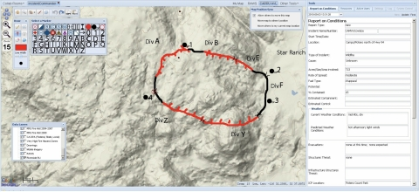
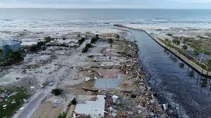
Civil Air Patrol Automatic Image Annotation
Connor Grimberg & Joseph Lee

Slide 2

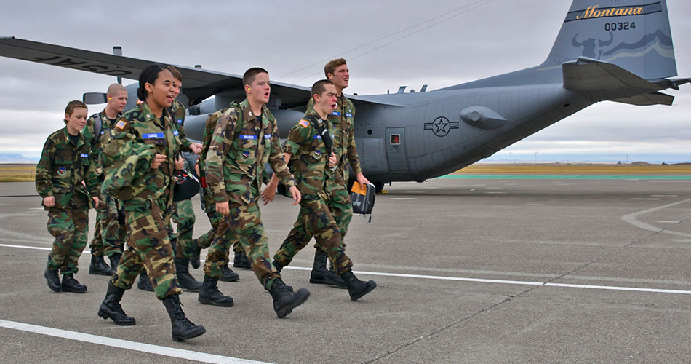
Civil Air Patrol (CAP)
3 depts.
Air force military cadets
Aerial photos of disaster area
Used for: disaster assessment and / or search & rescue

Slide 3
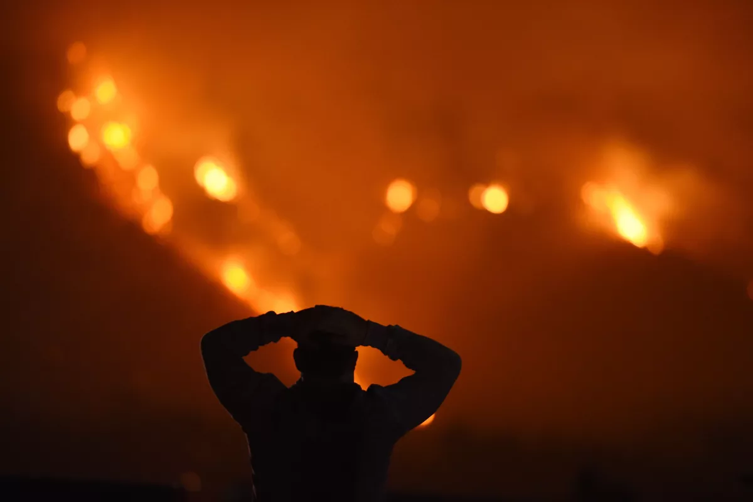

The Problem / Motivation
Disaster response = slow
Lives on the line!
Reduce time with automation
Notes:
https://communities.geoplatform.gov/disasters/civil-air-patrol-cap-browser/
The Civil Air Patrol (CAP) is a nonprofit corporation that assists people in need of help especially after a disaster, most commonly a hurricane. CAP provides numerous aerial imagery of inundated areas, failed dams and things relating to natural disasters. Analysis of the imagery aids FEMA in the decisions process leading to more effective, survivor centric, response. Currently, the workers at CAP upload and annotate thousands of images by hand.
State of the art: CAP
Next-Generation ICS

Slide 4

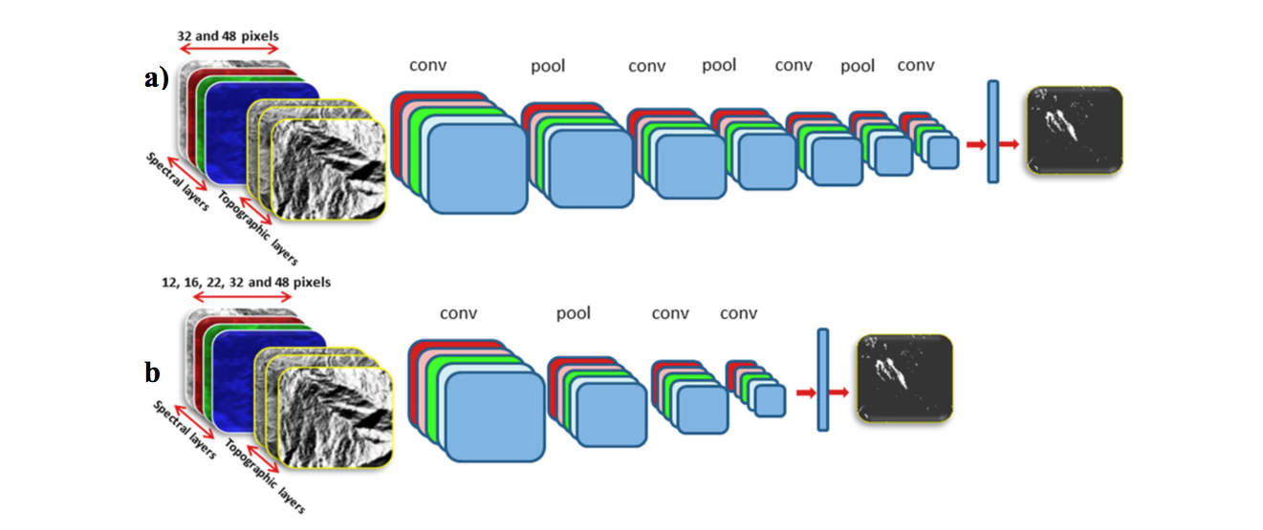
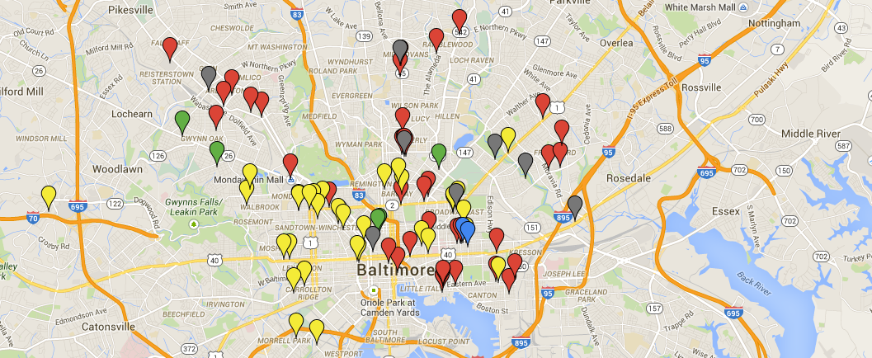
Our Solution
Easy-to-use web application
Input: image folder
Output: Autonomous annotation
Severity rating → map → rescue teams
Using A.I. techniques (e.g. Convolutional Neural Networks (CNN))
Notes:
We want to create a program that can take many images and autonomously annotate them, so workers at CAP won’t have to. We would also like to include several features such as, severity rating of each picture/location, and an easy-to-use website that helps navigate the large amount of images CAP takes.
Disaster map?

Slide 5
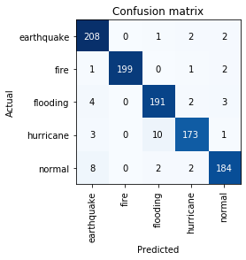
Progress So Far: CNN
4.40% error
Overfitted?
Our dataset = google images
Want to get other datasets

Slide 6
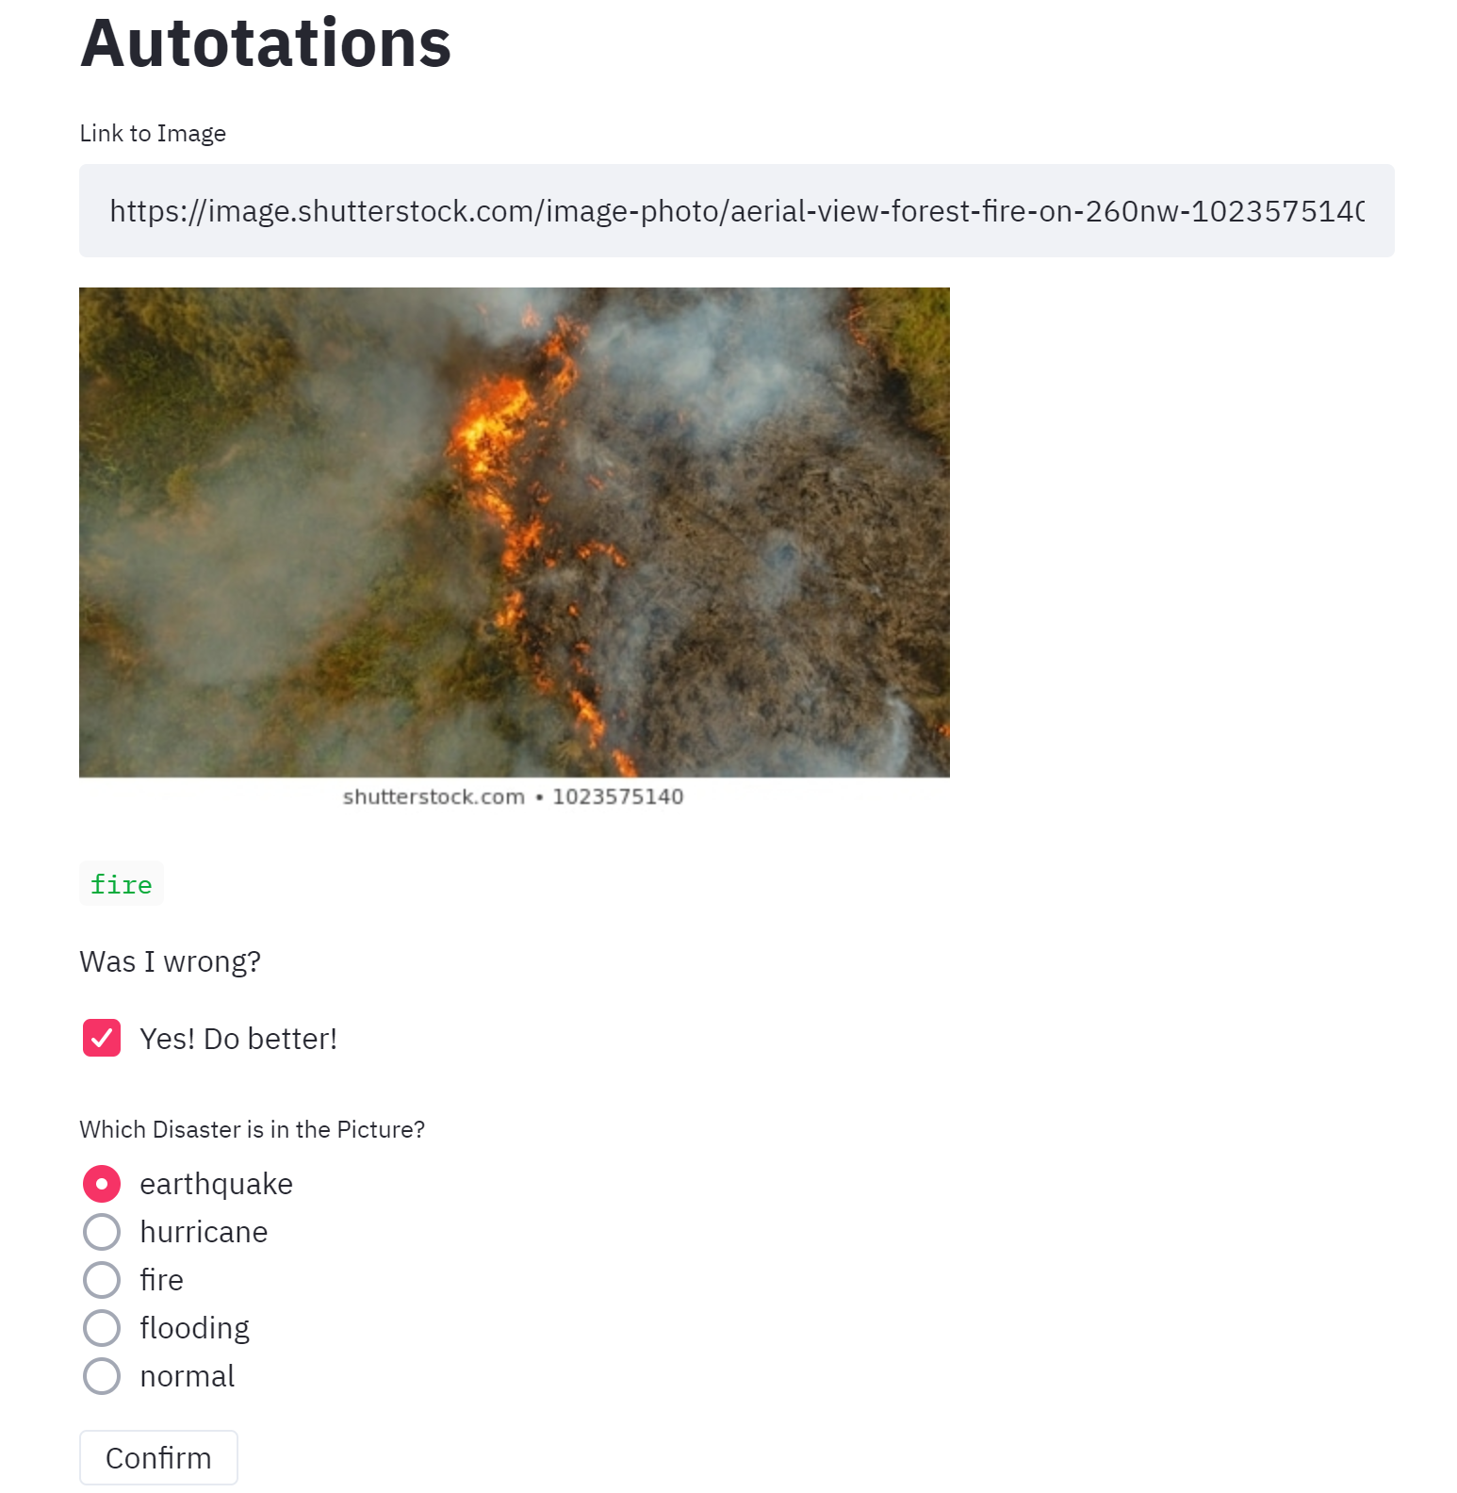
Web App
StreamLit
New library
Compatible with Director?
Easy-to-use
Flask → Director instead?

